Slide 1
Children’s versus non-children’s hospitals: Evaluating the pediatric differential
Ian McCarthy, PhD
Mehul Raval, MD, MS
This project was supported by grant number R01HS024712 from the Agency for Healthcare Research and Quality. The content is solely the responsibility of the authors and does not necessarily represent the official views of the Agency for Healthcare Research and Quality.

Slide 2
Motivation
Increased spending on pediatric care
Growth of stand-alone children’s hospitals
Differential costs between children’s and non-children’s hospitals

Slide 3
#1: Increased spending on pediatric care
Year | Overall Spending (<65 yrs) | Pediatric Care (0-18 yrs)
2011 | $4,514 (4.0% growth) | $2,356 (7.9% growth)
2012 | $4,653 (3.1% growth) | $2,453 (4.1% growth)
2013 | $4,790 (3.0% growth) | $2,560 (4.4% growth)
2014 | $4,915 (2.6% growth) | $2,664 (3.3% growth)
2015 | $5,141 (4.6% growth) | $2,791 (5.6% growth)
From 2013 and 2015 Health Care Cost and Utilization Reports, Health Care Cost Institute

Slide 4
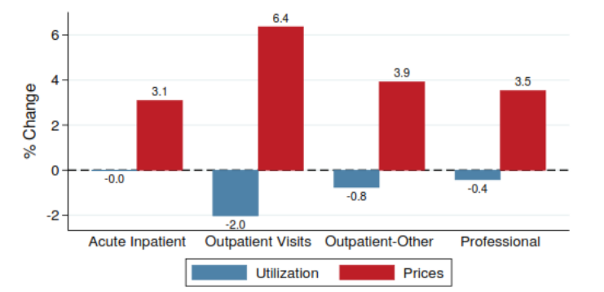
#1: Increased spending on pediatric care
Utilization and Price Growth from 2013-2014
Children’s Health Spending: 2010-2014, Health Care Cost Institute, May 2016

Slide 5
#2: Growth of stand-alone children’s hospitals
Kids’ Inpatient Database (KID), with costs estimated using cost-to-charge ratios

Slide 6
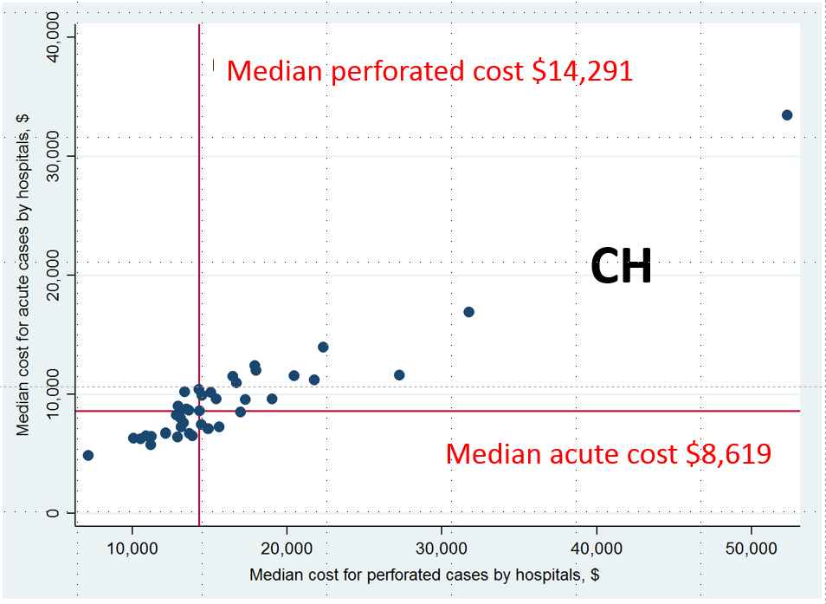
#3: Differential Costs among CH and NCH
Kids’ Inpatient Database (KID), with costs estimated using cost-to-charge ratios

Slide 7
Aims of Grant
Evaluate quality of care at CH versus NCH
Evaluate private insurance payments at CH versus NCH
Focus on 11 common surgical procedures
Quality measures: readmission, infections, and procedure-specific measures (e.g., negative appendectomy rates)
Price: allowed amounts from private insurance claims (Health Care Cost Institute)

Slide 8
Contributions
What drives any differences between CH and NCH?
Different patient populations?
Different organizational structure (e.g., teaching hospitals)?
Market structure and presence of competing CH versus NCH?
Cross-subsidization of other, less profitable, services?
Patient preference for “kid-friendly” environment?

Slide 9

Market Structure
U.S. News & World Report, 2013

Slide 10
Policy Relevance
Identify drivers of quality and pricing differentials between CH and NCH.
Examine the role of specialty hospitals for relatively common procedures.

